Slide 1
Logistic Regression

Slide 2
Agenda
Types of Supervised Learning
Standard process for Data Science Project
Visiting Basics
  Odds Ratio
Binomial Logistic Regression
  Maximum Likelihood Estimation
  Assumptions of Logistic Regression
  Significance of Coefficients

Slide 3
Agenda
Model Evaluation Metrics
  Deviance
  AIC
  Pseudo R²
Model Performance Measures
  Confusion Matrix
  Cross Entropy
  ROC - AUC Score
Imbalanced Data

Slide 4
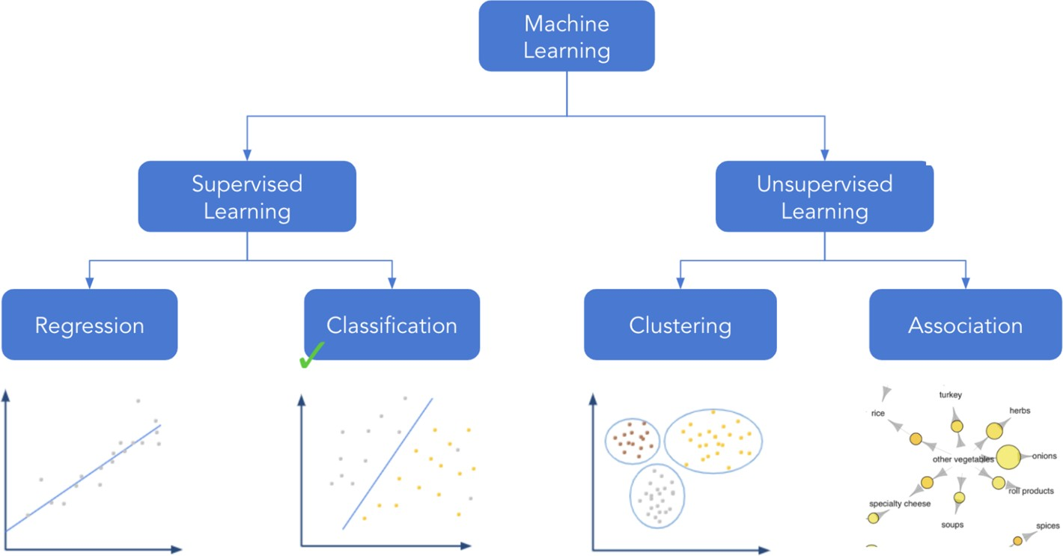
In this session, we shall cover classification

Slide 5
Supervised learning
Supervised learning aims at finding a model that maps the output (target) variable to the
input (predictor) variables
Labelled
data
Supervised
algorithm
Mapping function
Input
Mapping function
Output
Training Testing
Example: Detection of phishing emails based on certain phrases like ‘You have won million’. More such phrases are prespecified while training the model. So if a new email also contains a similar phrase such emails can directly be tagged as spam.

Slide 6
Supervised learning problems
Supervised learning is mainly used for two types of problems:
Regression problem
Classification problem

Slide 7


Regression vs classification
Supervised Learning
Regression
Classification
Target variable is continuous
Target variable is
categorical

Slide 8
Classification

Slide 9
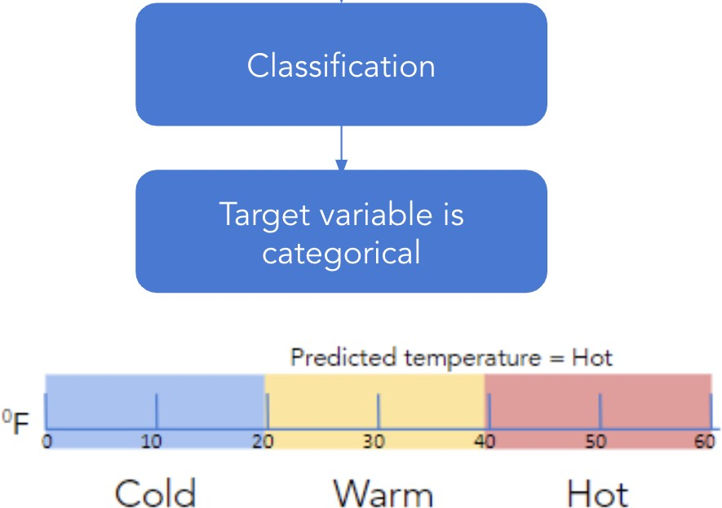
Class label
For classification, the target variable has
categories.
In the example, Cold, Warm and Hot are the
categories of the target variable.
These categories are called the class labels.

Slide 10
Classification
An instance is mapped to one of many available labels
Labels are the fixed number of values taken by the target variable
The machine learns the pattern from train data where the labels are known for all instances. Then the learning can be used on new data where labels need to be predicted

Slide 11
Types of classification
Binary classification:
Classification with only two class labels
Example: Emails can be classified into spam and ham
Multiclass classification:
Classification with more than two distinct class labels Example: Classification of land based on types of soils
  Will a customer default? (Yes/No)
  Is a transaction fraudulent?
  Will a customer respond to an offer?

Slide 12
CRISP-DM
Cross Industry Standard Process for Data Mining (CRISP-DM) is a standard process used
for data mining

Slide 13
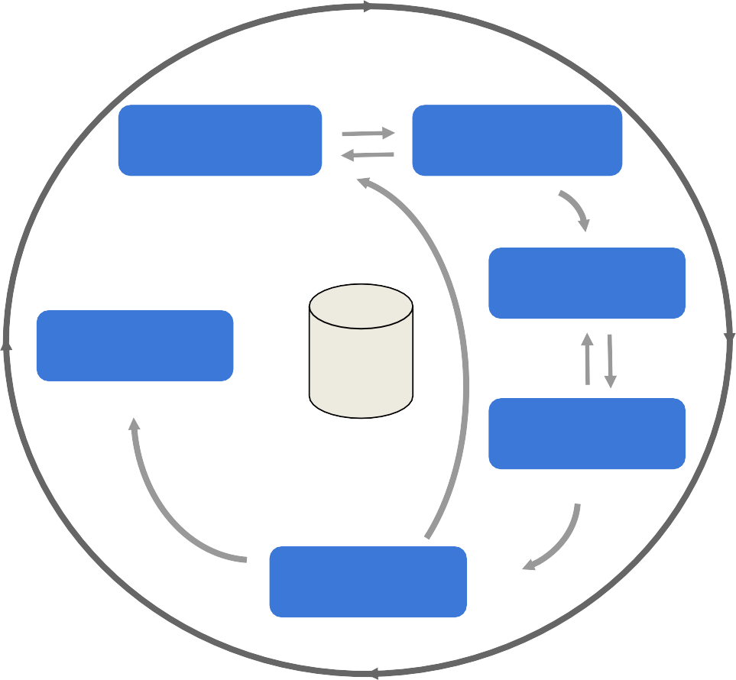
CRISP-DM phases
Business
Understanding
Data
Understanding
CRISP-DM breaks data mining
into six phases:
Data
Preparation
Business Understanding
Data Understanding
Data Preparation
Modeling
Evaluation
Deployment
Deployment
Data
Modeling
Evaluation

Slide 14
Odds vs probability
Odds of an event are the ratio of number of observations in favour of an event to number of observations not in favour of the event
Probability of an event is the ratio of number of observations in favour of an event to all possible observations

Slide 15
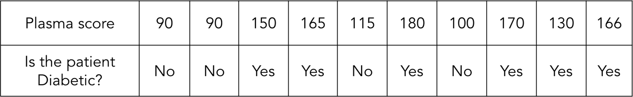
Odds vs probability
For the above data, the odds of a patient
having diabetes is given by,
For the above data,, the probability of a
patient having diabetes is given by,

Slide 16
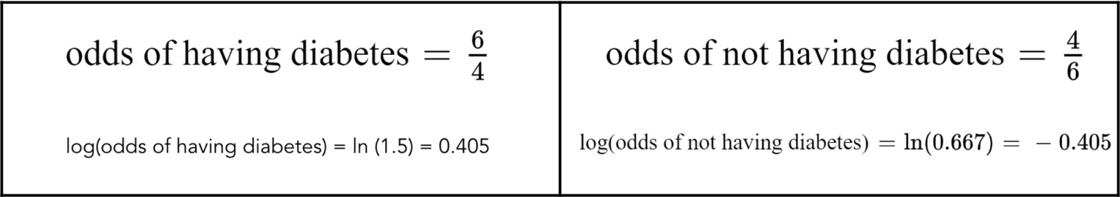
Log of odds
Note: ln=natural logarithm with base e.
As we can see if we only consider odds value, the magnitude for each class value
taken by variable is very different
Hence, the log(odds) value is considered; so that no matter whichever the class is, the
magnitude remains same
Log of odds is the logit function used in logistic regression

Slide 17
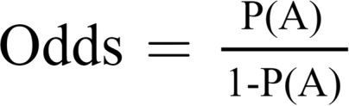
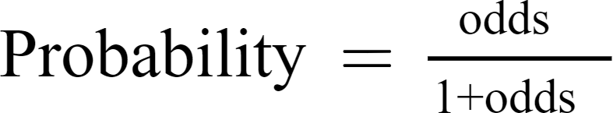
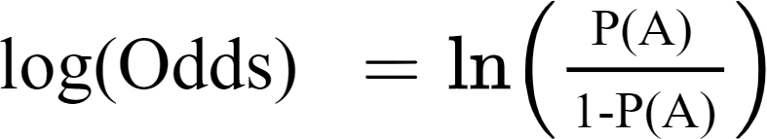
Relation between odds and probability
If P(A) is probability of event A

Slide 18

Odds ratio
Odds ratio refers to the ratio of odds
Odds ratio can be used to determine the impact of a feature on target variable
For our considered example the odds ratio can be calculated as,

Slide 19

Question:
Patients with high sugar diet are considered more susceptible to diabetes. How can we determine whether sugar content in diet has an impact on possibility of a patient getting diagnosed with diabetes? Consider the following sample data.
Sugar content in diet | High | High | Low | High | Low | High | High | Low | High | Low
Is the patient Diabetic? | Yes | No | Yes | Yes | No | Yes | Yes | No | No | No

Slide 20
Solution:
From the given sample data we can calculate:
1. Odds of a patient having diabetes given he has high sugar diet
2. Odds of a patient having diabetes given he has low sugar diet

Slide 21
Solution continued:
From 1 and 2 we can calculate odds ratio:
Thus from the odds ratio we can see that patients with a high sugar diet are 6 times more
susceptible to diabetes compared to patients who have a low sugar diet.

Slide 22
Binomial Logistic Regression

Slide 23
Question:
Consider the example below about whether or not a patient has diabetes based on plasma score. Can we use linear regression line to predict the whether the patient is diabetic?
Plasma score | 90 | 90 | 150 | 165 | 115 | 180 | 100 | 170 | 130 | 166
Is the patient Diabetic? | No | No | Yes | Yes | No | Yes | No | Yes | Yes | Yes

Slide 24
Answer:
The example about whether or not a patient has diabetes based on plasma score is a classification problem. Moreover, the target variable is categorical. Hence, we can not use linear regression line to predict the whether the patient is diabetic. We classify them as diabetic and non-diabetic.
Plasma score | 90 | 90 | 150 | 165 | 115 | 180 | 100 | 170 | 130 | 166
Is the patient Diabetic? | No | No | Yes | Yes | No | Yes | No | Yes | Yes | Yes

Slide 25
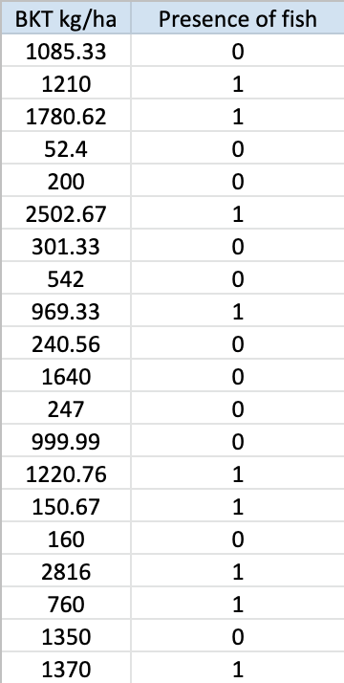
Logistic regression
Here on we shall consider the adjacent data
The data tells us the presence of one fish depending on the density of other fish in a lake
If they compete with each other, then the higher density of one may suggest the absence of the other whereas if they are symbiotic, high density of one may promote the other

Slide 26
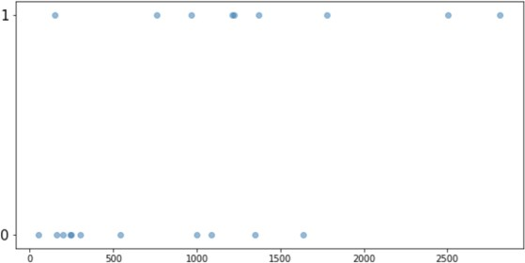
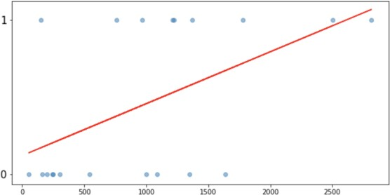
Logistic regression
Consider the scatter plot of the previous data
(data on slide 42)
Fit a linear regression line to it
Note the line is not a true representative of the
data

Slide 27
Logistic regression
A S-shaped curve as in the figure below
gives the true relationship
Such a curve is given by the sigmoid
function

Slide 28

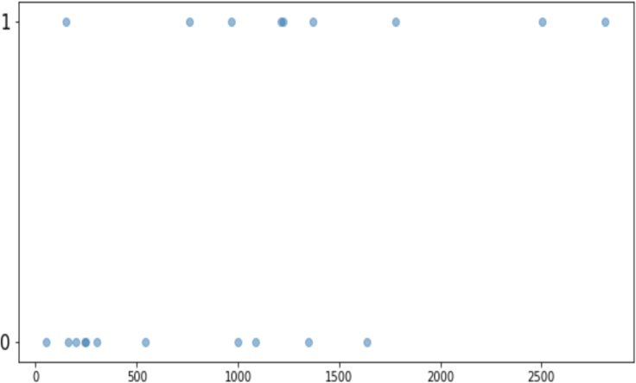
What is a sigmoid function?
The sigmoid function is a mathematical function which is S-shaped and is given by
It exists between 0 to 1

Slide 29
Logistic regression
Logistic regression is a binary classification algorithm
It predicts the probability of occurrence of a class label. Based on these probabilities
the data points are labelled
A threshold (or cut-off; commonly a threshold of 0.5 is used) is fixed, then
 | Classify as
threshold < probability | Presence of fish
Probability > threshold | Absence of fish

Slide 30
Main steps in logistic regression
Consider that logistic regression is used to identify whether or not a patient is suffering from diabetes
Logistic regression
Yes
Fish is
present
Input data instance
Predict probability
^{for P}present
Is P_{present}>Threshold?
Fish is absent
No

Slide 31
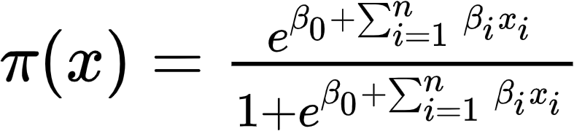
Logistic regression
The logistics regression is given by
Here, π(x) is the conditional expectation of the outcome given the values for
independent variables, i.e. E(Y|X)
It predicts the probability of occurrence of a class label by fitting the data to a function
called logit function, hence called logit regression

Slide 32



Probability as output of logistic regression
The logistic regression model is given by
Taking limits tending to -∞ on both side,
Taking limits tending to ∞ on both side,
Thus π(x) lies in-between 0 and 1, i.e. π(x) ∈ [0,1] and can be viewed as probability

Slide 33
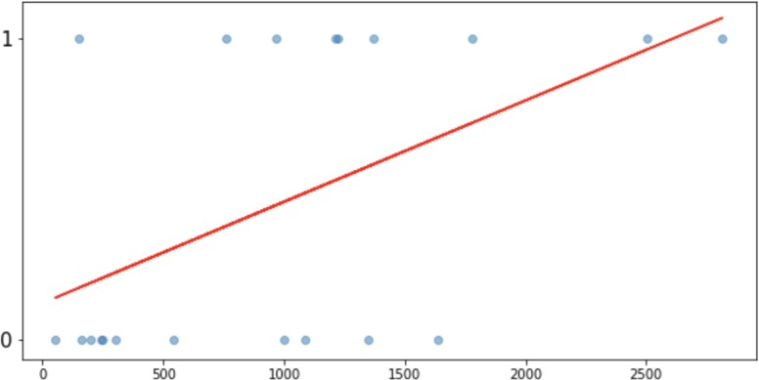
Logistic regression
Since we are predicting probabilities values
need to be between 0 and 1
Consider the points A and B for which values for plasma score are 80 and 177 respectively, probability values are out of the expected range 0 to 1
Hence linear regression cannot be directly
used to predict probabilities

Slide 34
Usage
Classification:
The ICU in a hospital is assigned on priority to high risk patients. Logistic regression
can be used to classify the list of patients into high risk and low risk records.
Profiling:
Nuclear fuel companies moderate various factors like pressure, temperature, etc. to produce high yielding and low yielding fuels. Based on different parameters for the current day, it can be predetermined whether the fuel produced will be high yielding or not. The company can then alter the parameters to produce high yielding fuel every day.

Slide 35
Question:
Consider the example below about whether or not a patient has diabetes based on plasma score. Since the logistic regression equation for this example will represent a straight line can we determine the residual values?
Plasma score | 90 | 90 | 150 | 165 | 115 | 180 | 100 | 170
Is the patient Diabetic? | No | No | Yes | Ye s | No | Yes | No | Yes

Slide 36
Assumptions of Logistic Regression

Slide 37
Assumptions
We have seen that the logistic regression can be linearized, so it has assumptions almost
same as that of linear regression
Assumption 1 | Independence of error, whereby all sample group outcomes are separate from each other (i.e., there are no duplicate responses)
Assumption 2 | Linearity in the logit for any continuous independent variables
Assumption 3 | Absence of multicollinearity
Assumption 4 | lack of strongly influential outliers

Slide 38
Significance of Coefficients

Slide 39
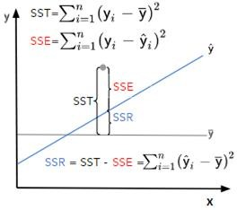
Significance of coefficients
For linear regression
In a linear regression model, the significance of a
regression coefficient is determined with the help of a t-test
In logistic regression, the significance of the coefficients is determined by the wald statistic and by the likelihood ratio test
To test the significance of the model, the likelihood ratio test
is used

Slide 40
Significance of coefficients - Wald test
For β to be significant, β > 0.
H₀ : β = 0 against H₁ : β ≠ 0
It implies
        H₀: The parameter β is not significant
against
H₁: The parameter β is significant
Failing to reject H₀ implies that the parameter β is not significant

Slide 41
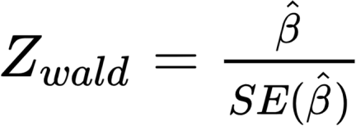

Significance of coefficients - Wald test
The Wald statistic is given by
where
is the estimated value of β.
The Wald statistic follows the N(0,1) distribution
Decision Rule: Reject H₀ if |Z|> Z_{α/2} or if the p-value is less than the α (level of
significance)

Slide 42
Significance of coefficients - LRT
For β to be significant, β > 0
H₀ : β = 0 against H₁ : β ≠ 0
It implies
H₀: The parameter β is not significant
against
H₁: The parameter β is significant
Failing to reject H₀ implies that the parameter β is not significant

Slide 43

Significance of coefficients - LRT
The likelihood ratio test (LRT) is given by
D follows the chi-squared distribution with one degree of freedom, i.e. χ₁
Decision Rule: Reject H₀ if χ ≥ χ_{α/2} or if the p-value is less than the α (level of
significance)

Slide 44
Significance of model - LRT
The hypothesis for testing all coefficient in logistic regression can be extended from
the previous test for one coefficient as follows
H₀: β₁ = β₂ = β₃ = 0 against H₁: At least one β_{k} ≠ 0 (k =1,2,3)
It implies
H₀: the logistic model is not significant
against
H₁: the logistic model is significant

Slide 45
Significance of model - LRT
The likelihood ratio test is given by
D follows the chi-squared distribution with one degree of freedom, i.e. χ₁
Decision Rule: Reject H₀ if χ ≥ χ_{α/2} or if the p-value is less than the α (level of
significance)

Slide 46
Model Evaluation Metrics

Slide 47
Model Performance Measures

Slide 48
Performance metrics
The following metrics can be used to evaluate the performance of classification models:
Confusion matrix
Cross entropy
ROC

Slide 49
Performance metrics
We shall consider the fish data as
described before

Slide 50
Performance metrics
The following metrics can be used to evaluate the performance of classification models:
Confusion matrix
Cross entropy
ROC

Slide 51
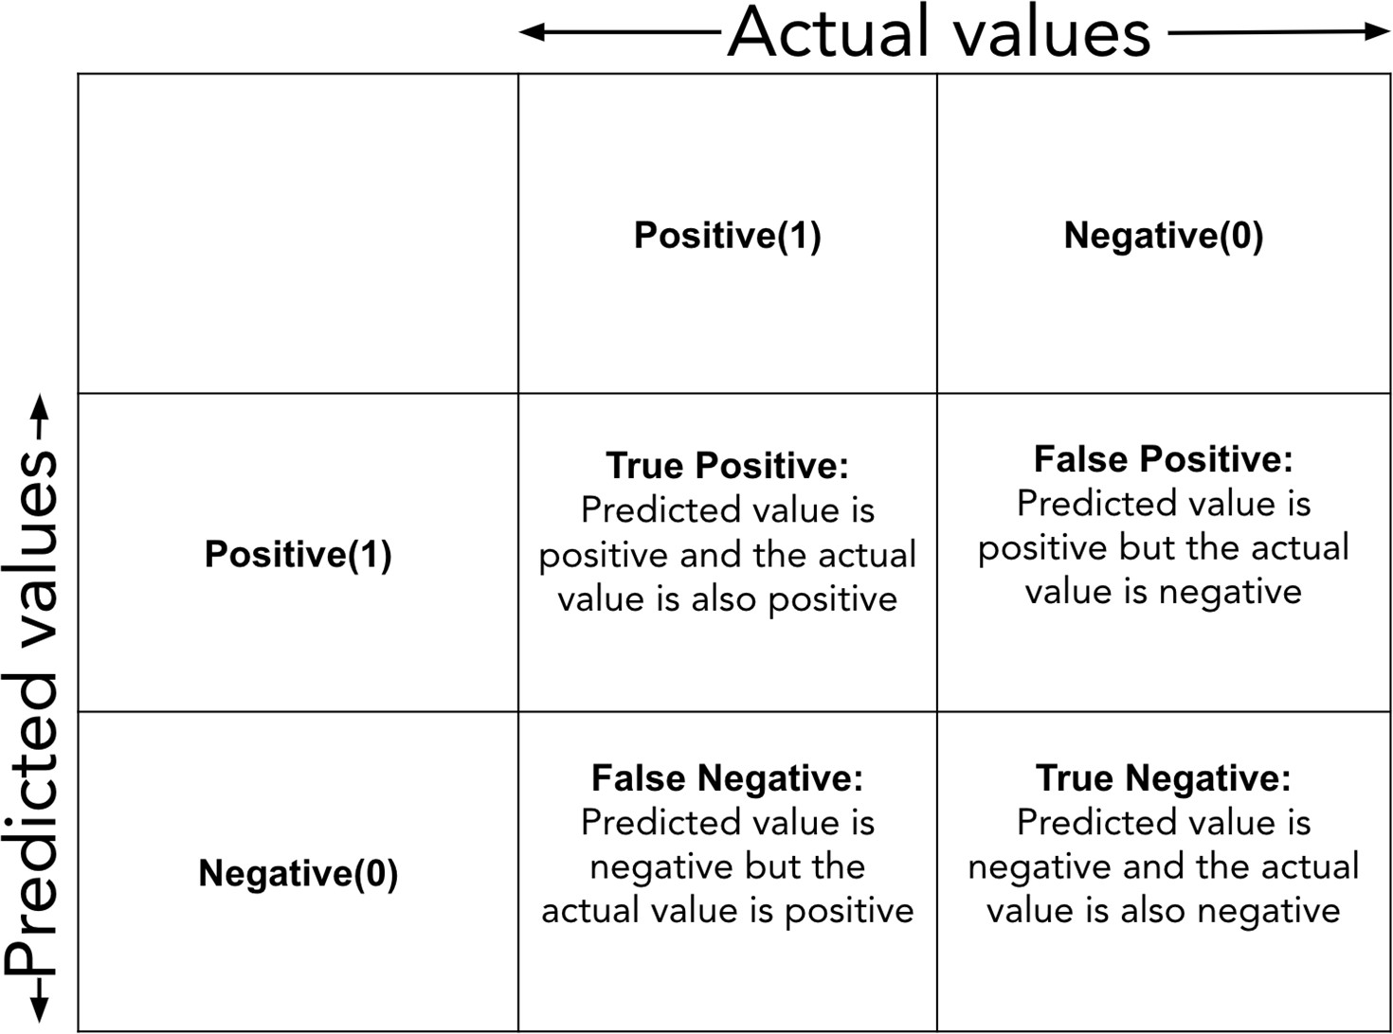
Confusion matrix
Performance measure for classification problem
It is a table used to compare predicted and actual values of the target variable

Slide 52
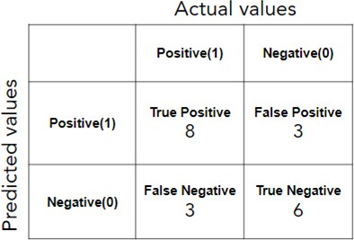
Confusion matrix for our example
Example Scenario (Medical Diagnosis)
Imagine a model detecting Cancer (Positive) vs. No Cancer (Negative).
TP: Correctly identifies a patient with cancer.
TN: Correctly identifies a patient without cancer.
FP: Calls a healthy person "cancerous" (bad false alarm).
FN: Misses a cancerous person (dangerous missed diagnosis).
true positives (TP): These are cases in which we predicted positive (they have the disease), and they do have the disease.
true negatives (TN): We predicted negative, and they don't have the disease.
false positives (FP): We predicted positive, but they don't actually have the disease. (Also known as a "Type I error.")
false negatives (FN): We predicted negative, but they actually do have the disease. (Also known as a "Type II error.")

Slide 53
Performance evaluation metrics
Confusion matrix can be used to calculate the following evaluation metrics for a model:
Accuracy
Precision
Recall
False Positive Rate
Specificity
F₁ score
Kappa

Slide 54
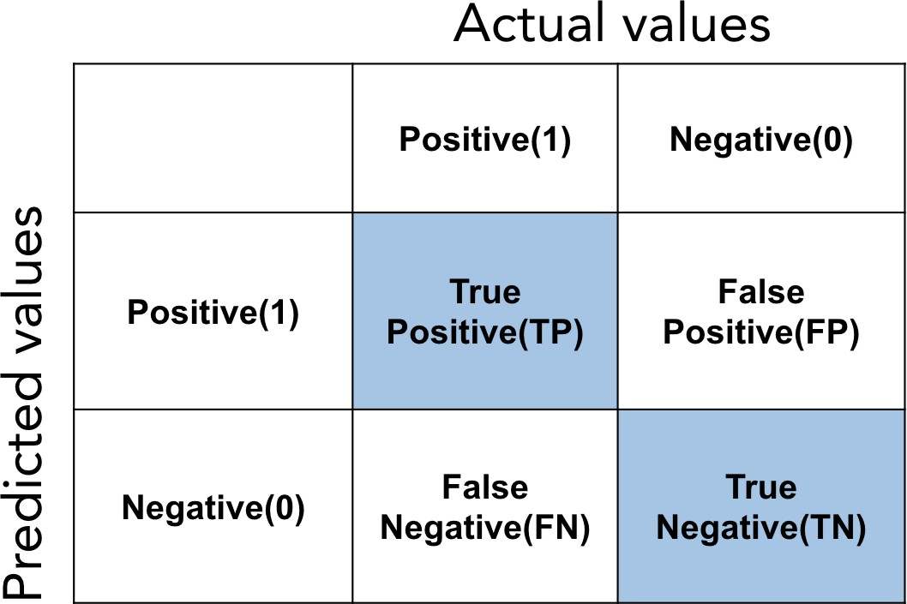
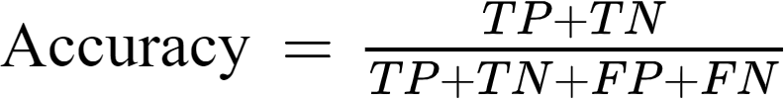
Accuracy
Accuracy is the fraction of predictions that out model got correct
Higher the value of accuracy better is the
model

Slide 55

Accuracy is not always a reliable metric
Consider a dataset with information about 1000 patients. 960 of those patients have diabetes and only 40 do not have diabetes. We have a model ‘A’ that classifies every patient as diabetic.
Even though the accuracy for model A is high it is not a good model. Since even when it will encounter information about a new patient it will always predict that the patient is diabetic. This scenario when accuracy is not a reliable metric is called the accuracy paradox.

Slide 56
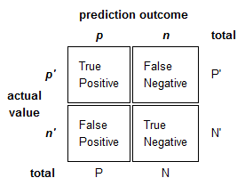

Precision
Precision is proportion of positive cases that
were correctly predicted
Higher is the precision better the model

Slide 57

Recall
Recall is the proportion of actual positive
cases that were correctly predicted
Recall is also sometimes called True Positive
Rate (TPR) or Sensitivity
It is important in medical cases where it doesn’t matter whether we raise a false alarm but the actual positive cases should not go undetected!
Higher value of TPR implies a better model

Slide 58

False positive rate
False Positive Rate (FPR) is the proportion of actual negative cases that were predicted positive (incorrectly)
Lower the value of FPR better is the model

Slide 59
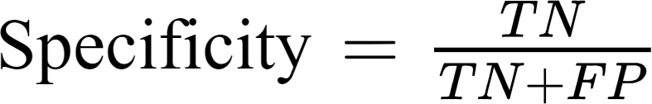
Specificity
Specificity is the proportion of actual negative
cases that were correctly predicted
Higher the specificity better is the model

Slide 60

F₁ score
F₁ score is the harmonic mean of precision and recall values for a classification model
It is a good measure if we want to find a balance between precision and recall or if there is an uneven distribution of classes (either positive or negative class has way more actual instances than the other)
Higher the F₁ score better the model

Slide 61
Performance metrics
The following metrics can be used to evaluate the performance of classification models:
Confusion matrix
Cross entropy
ROC

Slide 62

Cross Entropy
Cross entropy is the loss function commonly used in classification problems
As the prediction goes closer to actual value the cross entropy decreases
i = class (0 or 1)
H(y) = cross entropy
y_{act(i)} = actual probability for class i
y_{pred(i)} = predicted probability for class i

Slide 63
Calculation of cross entropy
Let us consider one observation from our considered example:
 | Actual probability | Predicted probability
Fish present | 1 | 0.72
Fish not present | 0 | 0.28

Slide 64
Performance metrics
The following metrics can be used to evaluate the performance of classification models:
Confusion matrix
Cross entropy
ROC

Slide 65

ROC
Receiver operating characteristics (ROC) curve
The TPR and FPR values change with different threshold values
ROC curve is the plot of TPR against the FPR values obtained at all possible threshold
values

Slide 66
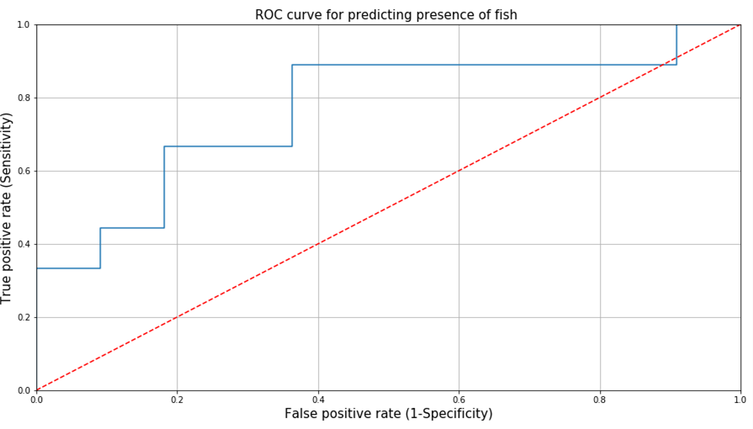
ROC curve for our example
shows how the model performs at different classification thresholds.
A higher curve = better model
A curve close to diagonal = poor model
A curve close to top-left = excellent model

Slide 67
AUC
Area under the ROC curve (AUC) is the measure of separability between the classes of target variables
AUC increases as the separation between the classes increases
Higher the AUC better the model
When AUC is equal to 1, the classifier is able to perfectly distinguish between all Positive and Negative class points.
When AUC is equal to 0, the classifier would be predicting all Negatives as Positives and vice versa. When AUC is 0.5, the classifier is not able to distinguish between the Positive and Negative classes.

Slide 68
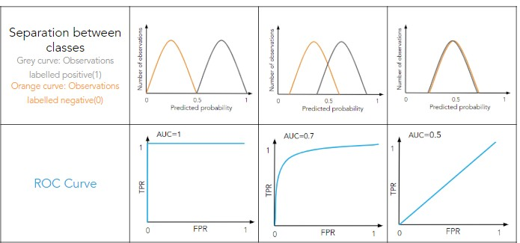
Effect of separation between classes on ROC

Slide 69
Imbalanced Data

Slide 70
Imbalanced data
Data is imbalanced if there are more records of one class compared to other classes
Imbalanced data may lead to the accuracy paradox
In reality datasets always have some degree of imbalance

Slide 71
Example of imbalanced data
For example : Consider we have information about 500 patients
 | Diabetic- Yes | Diabetic-No
Number of records | 79 | 421
% of records | 15.8 | 84.2

Slide 72
Handling imbalanced data
Up sample minority class
Down sample majority class
Change the performance metric
Try synthetic sampling approach
Use different algorithm

Slide 73
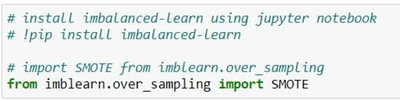
SMOTE
SMOTE (Synthetic Minority Oversampling Technique) is one of the most
used techniques to deal with an imbalanced data
It generates the synthetic samples for the minority class (a class with fewer
observations)
Python provides a library that provides different techniques to deal with an
imbalanced dataset

